Slide 1
MUSIC STORE DATA ANALYSIS
Presented by Ganesh Karwa

Slide 2
INTRODUCTION
Brief Overview of the Music Store Database:
Comprehensive relational database designed for an online music store.
Stores customer data, sales transactions, inventory details, and artist information.
Facilitates efficient sales tracking, customer management, and inventory control.
Use of PostgreSQL and PgAdmin4:
PostgreSQL: Open-source, highly customizable RDBMS with ACID compliance.
PgAdmin4: GUI tool for database management, query execution, and performance monitoring
Importance of Data Analysis in Decision-Making:
Drives strategic decisions by providing insights into customer behavior and market trends.
Enables informed choices based on evidence and quantitative analysis.
Identifies patterns, correlations, and opportunities within the data.
Supports performance monitoring, goal setting, and process optimization.

Slide 3
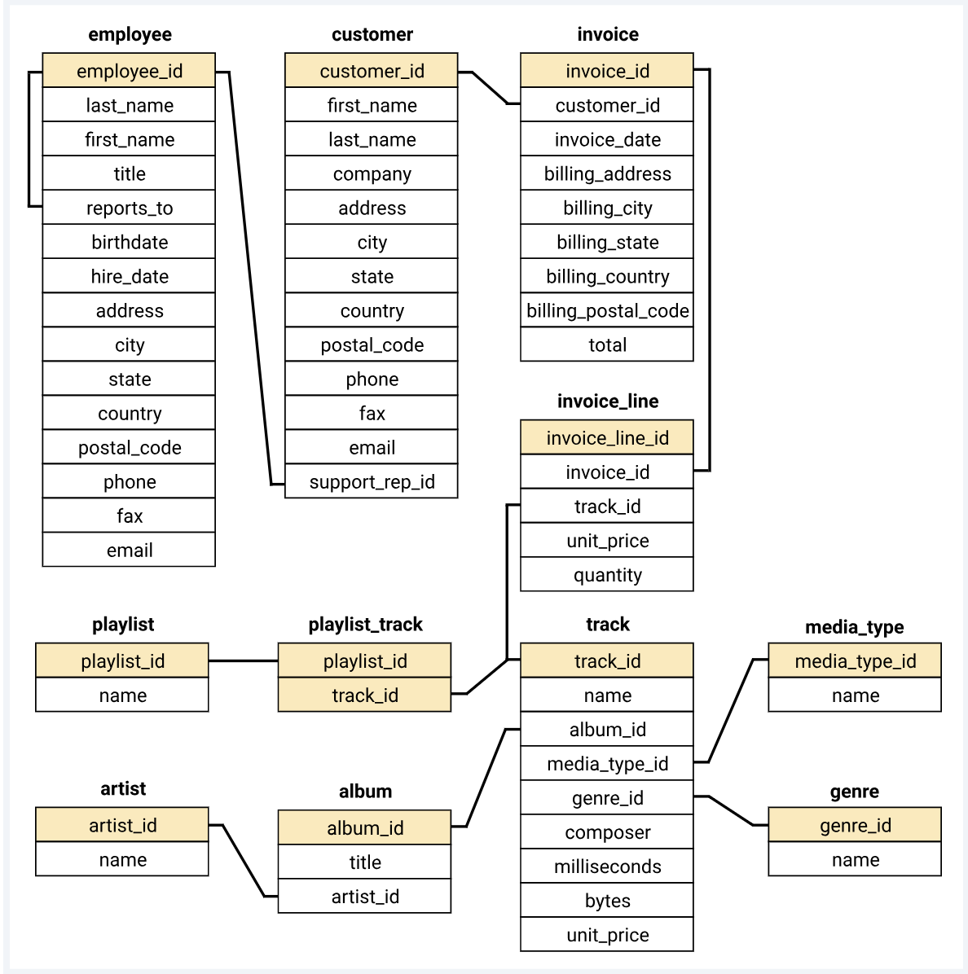
DATA OVERVIEM
SCHEMA

Slide 4
Dataset Overview
11 interconnected tables: Artist, Album, Track, Invoice, Invoice Line, Customer, and Employee.
Each table contains unique columns facilitating seamless connections.
Unique Columns:
Customer: customer_id
Invoice: invoice_id
Invoice Line: invoice_line_id
Track: track_id, album_id, genre_id
Album: album_id
Genre: genre_id
Artist: artist_id
Employee: employee_id
Relationships:
Customer → Invoice: customer_id
Invoice → Invoice Line: invoice_id
Track → Album: album_id
Track → Genre: genre_id

Slide 5
PROJECT PHASES
PHASES 1(EASY)
PHASES – 2(MODERATE)
PHASES – 3 (HARD)
()

Slide 6
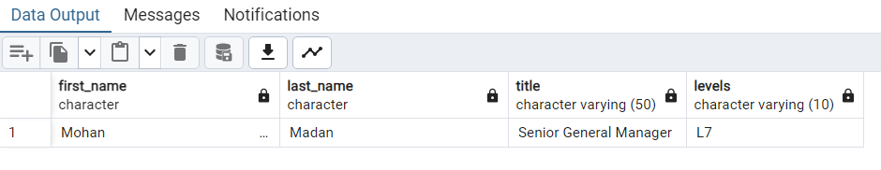
PHASE -1 LET’S GO
Q1 Who is the senior most employ based on job Titel?
SELECT * FROM employee
ORDER BY levels DESC
LIMIT 1;

Slide 7
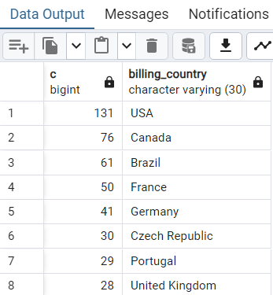
Q2 Which countries have the most Invoices?
SELECT COUNT(*) AS c, billing_country FROM invoice
GROUP BY billing_country ORDER BY c DESC ;

Slide 8
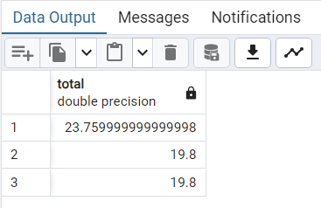
Q3 What are the top 3 values of the total invoice?
SELECT total FROM invoice
ORDER BY total DESC
LIMIT 3;

Slide 9
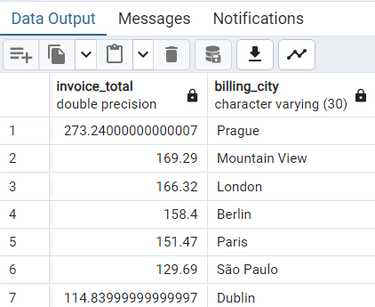
Q4 Which city has the best customers? We would like to throw a promotional Music Festival in the city where we made the most money.
Write a query that returns one city that has the highest sum of invoice total. Return both the city name & sum of all invoices total.
SELECT SUM(total) AS invoice_total,billing_city
FROM invoice
GROUPFROM BY billing_city
ORDER BY invoice_total DESC;

Slide 10
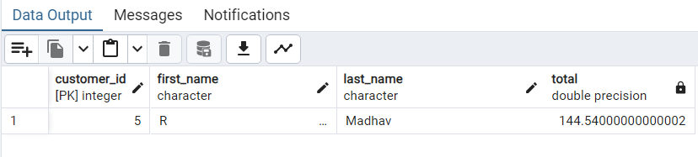
Q5 Who is the best customer? The customer who has spent the most money will be declared the best customer.
Write a query that returns the person who has spent the most money.
SELECT customer.customer_id,customer.first_name,customer.last_name , SUM(invoice.total) AS total
FROM customer JOIN invoice ON customer.customer_id= invoice.customer_id
GROUP BY customer.customer_id
ORDER BY total DESC
LIMIT 1;

Slide 11
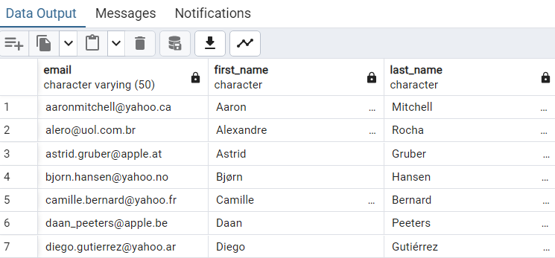
PHASE -2 LET’S GO
Q1 Write a query to return the email, first name, last name,& Genre of all Rock Music listeners. Return your list ordered alphabetically
by email start with A
SELECT DISTINCT email, first_name, last_name
FROM customer JOIN invoice ON customer.customer_id= invoice.customer_id
JOIN invoice_line ON invoice.invoice_id = invoice_line.invoice_id
WHERE track_id IN
(
SELECT track_id FROM track
JOIN genre ON track.genre_id = genre.genre_id --( inner query)
WHERE genre.name LIKE 'Rock'
)
ORDER BY email

Slide 12
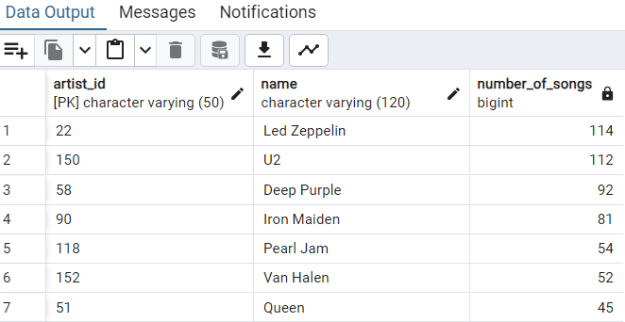
Q2 Lets invite the artist who has written the most rock music in our dataset.
Write a query that returns the Artist name and total track count of the 10 rock bands
SELECT artist.artist_id,artist.name,COUNT(artist.artist_id) AS number_of_songs
FROM track
JOIN album ON album.album_id = track.album_id
JOIN artist ON artist.artist_id = album.artist_id
JOIN genre ON genre.genre_id = track.genre_id
WHERE genre.name LIKE 'Rock'
GROUP BY artist.artist_id
ORDER BY number_of_songs DESC
LIMIT 10;

Slide 13
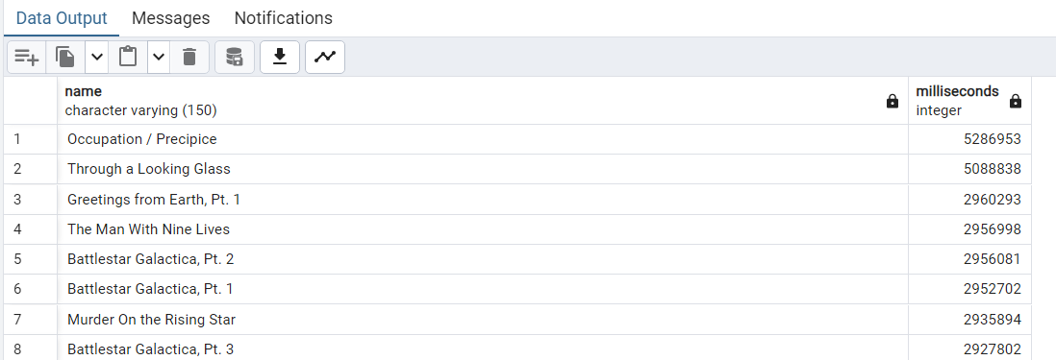
Q3 Return all the track names that have a song length longer than the average song length.
Return the Name and Milliseconds for each track. Order by the song length with the longest songs listed first
SELECT NAME, milliseconds
FROM track
WHERE milliseconds >
(
SELECT AVG(milliseconds) AS avg_track_length
FROM track
)
ORDER BY milliseconds DESC;

Slide 14
PHASE -3 LET’S GO
Q1 Find how much amount spent by each customer on an artist.
Write a query to return the customer name, article, and total spent.
WITH best_selling_artist AS (
SELECT artist.artist_id AS artist_id, artist.name AS artist_name, SUM(invoice_line.unit_price*invoice_line.quantity) AS total_sales
FROM invoice_line
JOIN track ON track.track_id = invoice_line.track_id
JOIN album ON album.album_id = track.album_id
JOIN artist ON artist.artist_id = album.artist_id
GROUP BY 1
ORDER BY 3 DESC
LIMIT 1
)
SELECT c.customer_id, c.first_name, c.last_name, bsa.artist_name, SUM(il.unit_price*il.quantity) AS amount_spent
FROM invoice i
JOIN customer c ON c.customer_id = i.customer_id
JOIN invoice_line il ON il.invoice_id = i.invoice_id
JOIN track t ON t.track_id = il.track_id
JOIN album alb ON alb.album_id = t.album_id
JOIN best_selling_artist bsa ON bsa.artist_id = alb.artist_id
GROUP BY 1,2,3,4
ORDER BY 5 DESC;

Slide 15
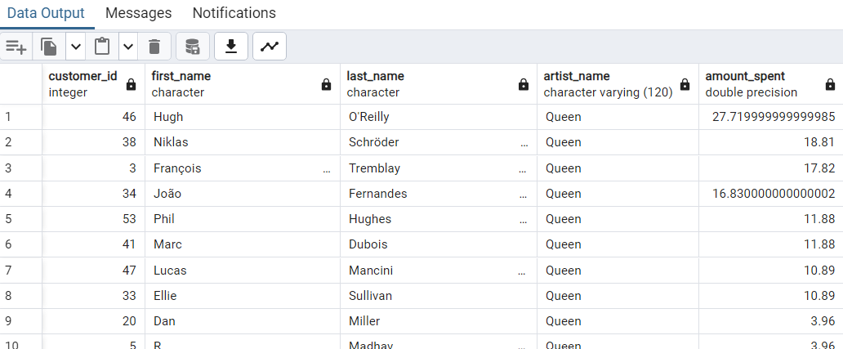

Slide 16
Q2: We want to find out the most popular music Genre for each country. We determine
the most popular genre as the genre
with the highest amount of purchases. Write a query that returns each country along with the top Genre. For countries where
the maximum number of purchases is shared return all Genres.
.
WITH popular_genre AS
(
SELECT COUNT(invoice_line.quantity) AS purchases, customer.country, genre.name, genre.genre_id,
ROW_NUMBER() OVER(PARTITION BY customer.country ORDER BY COUNT(invoice_line.quantity) DESC) AS RowNo
FROM invoice_line
JOIN invoice ON invoice.invoice_id = invoice_line.invoice_id
JOIN customer ON customer.customer_id = invoice.customer_id
JOIN track ON track.track_id = invoice_line.track_id
JOIN genre ON genre.genre_id = track.genre_id
GROUP BY 2,3,4
ORDER BY 2 ASC, 1 DESC
)
SELECT * FROM popular_genre WHERE RowNo <= 1

Slide 17
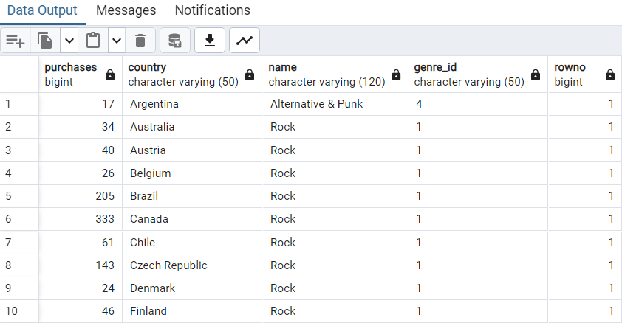

Slide 18
Q3: Write a query that determines the customer that has spent the most
on music for each country. Write a query that returns
the country along with the top customer and how much
they spent. For countries where the top amount spent is
shared, provide all customers who spent this amount
WITH Customter_with_country AS
(
SELECT customer.customer_id,first_name,last_name,billing_country,SUM(total) AS total_spending,
ROW_NUMBER() OVER(PARTITION BY billing_country ORDER BY SUM(total) DESC) AS RowNo
FROM invoice
JOIN customer ON customer.customer_id = invoice.customer_id
GROUP BY 1,2,3,4
ORDER BY 4 ASC,5 DESC
)
SELECT * FROM Customter_with_country WHERE RowNo <= 1

Slide 19
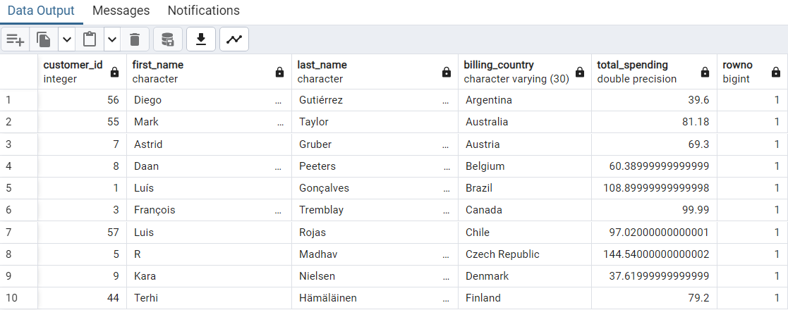

Slide 20
CONCLUSION
Top-selling items: The analysis revealed the best-selling music genres, best artists, albums and customers, top countries.
Customer segmentation: By analyzing customer behavior, we identified different customer segments based on their purchase history, preferences, and spending patterns.
Geographic trends: The analysis uncovered sales performance variations across different regions or countries.
Actionable Recommendations and Future Steps:
Enhance inventory management: Utilize the findings on top-selling items to optimize inventory levels and ensure the availability of popular genres, artists, and albums.
Continuously monitor and analyze data: Implement a robust data collection and analysis system to continuously monitor sales, customer

Slide 21
THANK YOU

